Slide 1
Mood-Based Classifier and Recommender System
Mid Project Presentation
Group-41

Slide 2
Motivation
Music deeply resonates with our emotions, yet choosing a song to match one's mood in today's vast digital library is daunting. Most platforms only suggest based on user history, neglecting the emotional aspect. Our project offers a Mood-Based Song Classifier and Recommender System, using machine learning to discern moods from recent song choices. We aim for a personalized listening experience, bridging the gap between emotions and song recommendations. Our goal is to align every song suggestion with the user's emotional state.

Slide 3
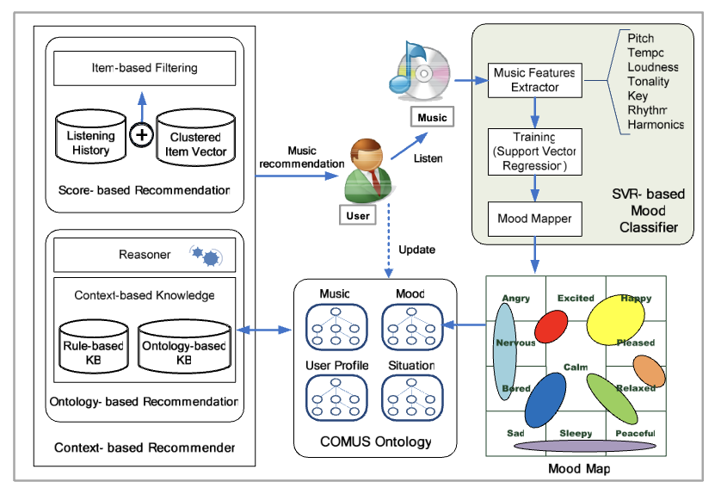
Literature Review
SVR-based music mood classification and context-based music recommendation by Seungmin Rho , Byeong-jun Han and Eenjun Hwang.
This paper focuses on context based
music recommendation. The authors
first classified the mood after converting
it into a regression problem based on
Support Vector Regression (SVR).For music
recommendation, they assess the user’s
mood and situation using both
collaborative filtering and ontology
technology.

Slide 4
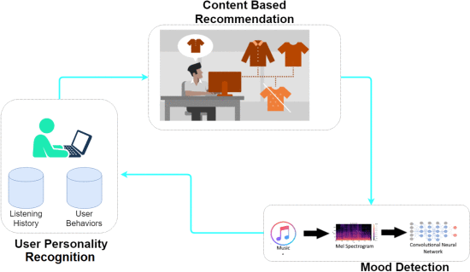
Literature Review
Moodplay: Interactive Mood-based Music Discovery and Recommendation by Ivana Andjelkovic, Denis Parra, John O’Donovan.
MoodPlay is a hybrid recommender system music which integrates content and mood-based filtering in an interactive interface. MoodPlay allows the user to explore a music collection by latent affective dimensions, by integrating user input at recommendation time with predictions based on a pre-existing user profile.
An Emotional Recommender System for Music by Vincenzo Moscato, Antonio Picariello and Giancarlo Sperli.
In this paper, the authors describe a novel
music recommendation technique based on
the identification of personality traits, moods,
and emotions of a single user. It embeds
users’ personality and mood with a content
-based filtering approach to obtain accurate
and dynamic results.

Slide 5
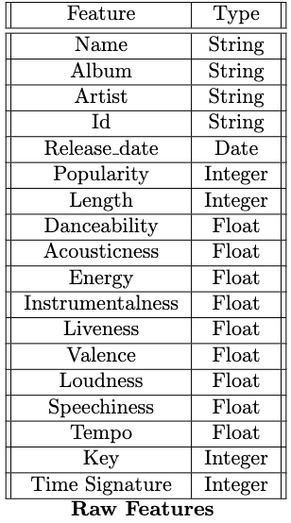
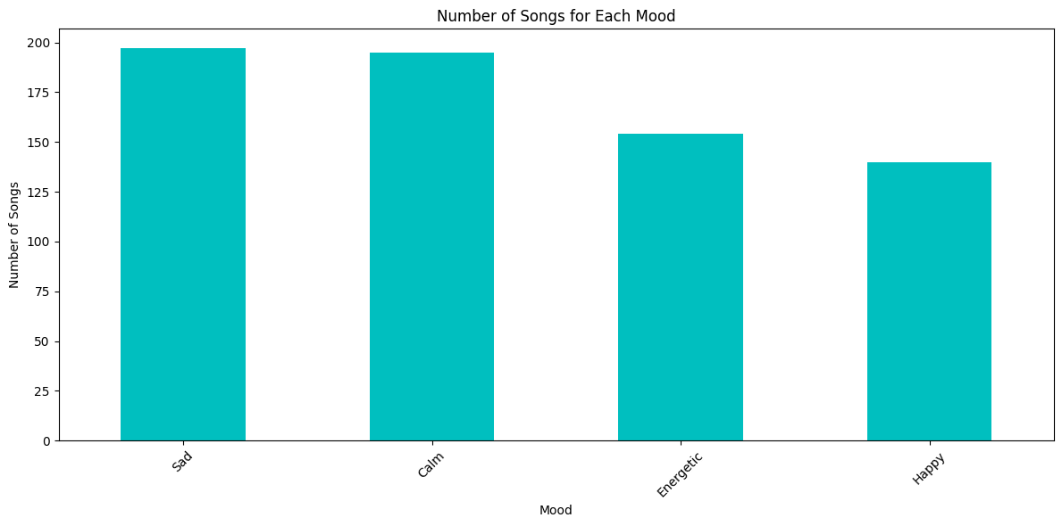
Dataset Description
We used the Spotify Music data [LINK] which contains 686 songs different artists and multiple genre. All the songs features were extracted using Spotify API.

Slide 6
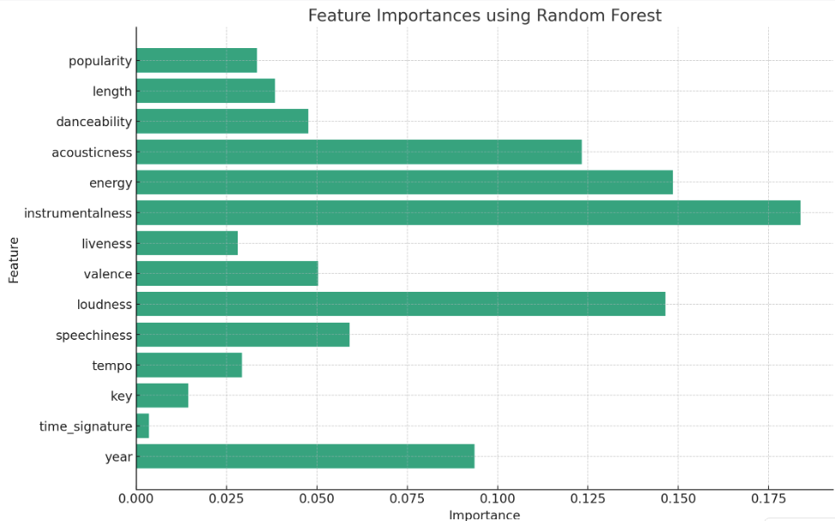
DataSet Preprocessing
Categorical Features such as name, album, artist, and id are dropped.
Numerical Features are standardised to ensure they have a mean of 0 and a standard deviation of 1.
Label encoding of categorical target label mood.
Feature Selection has been been done using Random Forest and based on the avg. impurity loss time signature and key are dropped.

Slide 7
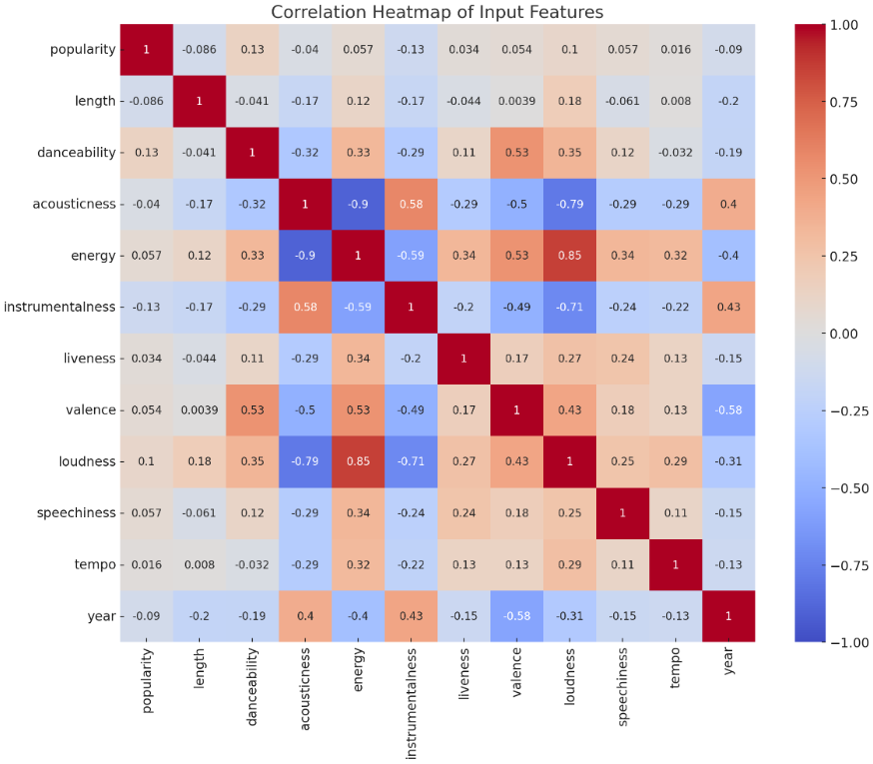
Dataset Visualisation
Positive Correlation:
Energy and Loudness
Negative Correlation: Acousticness and Energy

Slide 8
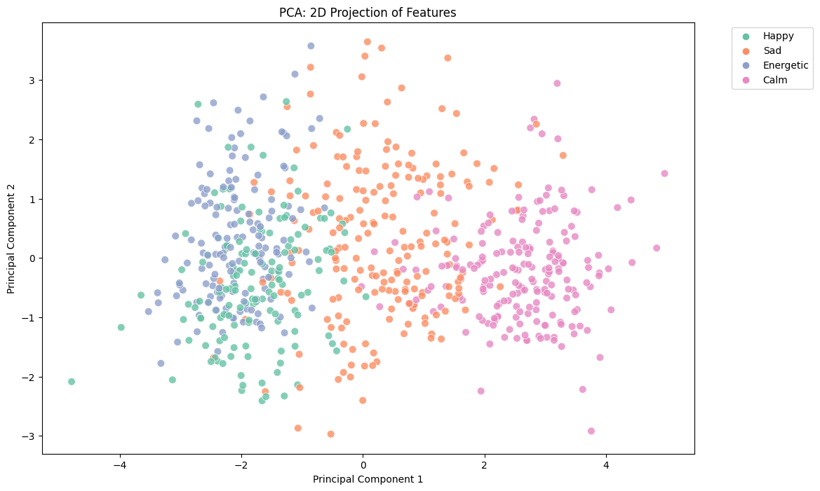
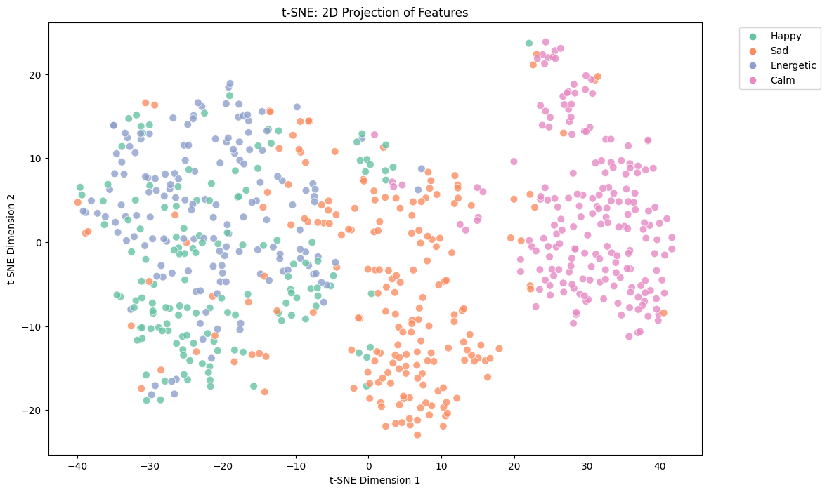
Data Visualization
Dimensionality Reduction
Principal Component Analysis
T-distributed Stochastic Neighbor Embedding
Moods are clearly separable (in separate clusters) except for energetic and happy songs, where there is a some amount of overlap.

Slide 9





Methodology
Classifier Models Tested up until now
Logistic Regression
Gaussian Naive Bayes
Decision Tree
Random Forest
Support Vector Machine
Linear
Polynomial
RBF
XGBoost Classifier

Slide 10
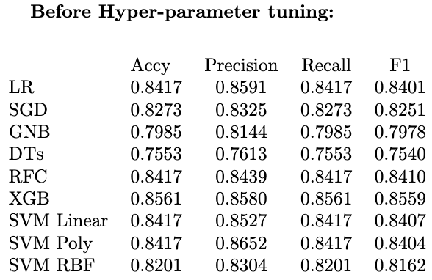
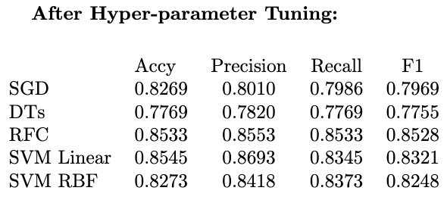
Results and Analysis
We selected Gaussian Naive Bayes and Decision Tree as the baseline models because of their minimal complexity.
We tested the models listed below and obtained the metrics before and after hyperparameter tuning with cross-validation (k=10).
Decision Trees, in particular, showed noticeable improvement after hyperparameter tuning, emphasizing the value of tuning especially for models with numerous parameters like trees.
SVM (both Linear and RBF kernel) also improved, suggesting that the default hyperparameters were not optimal for this dataset.

Slide 11
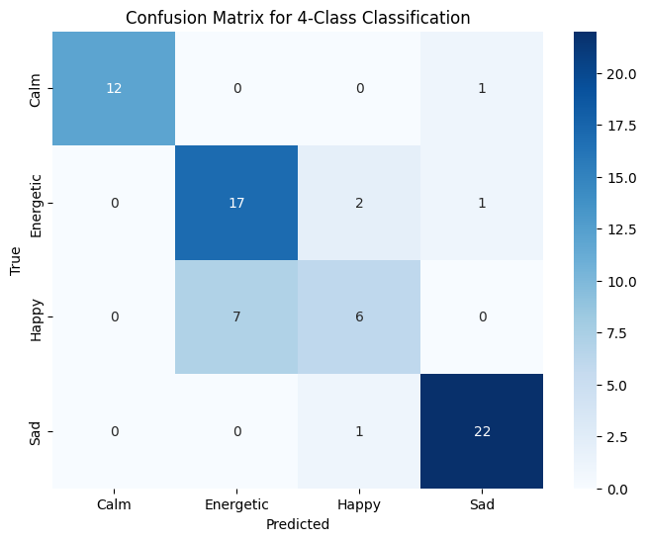
Results and Analysis
After hyper parameter tuning with cross-validation, we notice an improvement in the evaluation metrics of Random Forest , SVM, Decision Tree and SGD Classifier. There was no improvement in the evaluation metrics of the XGB model as it is already optimised.
We get the best results from
XGBoost Classifier and Random
Forests with accuracies of 85.61%
and 85.33% respectively.
This is because ensemble models
like Random Forest and XGB have
higher accuracy and F1 scores
compared to simpler models, given
their ability to capture complex
relationships and reduce overfitting.

Slide 12
Conclusion
We discovered that the features we have used are highly effective in discerning the mood of a song, and as a result, they can effectively represent the mood of the listener. The XGB Classifier model has yielded a promising metric score, which gives us the confidence to move forward and develop a recommender system for songs. This system will be capable of suggesting songs to users based on the mood of the song they are currently listening to.

Slide 13
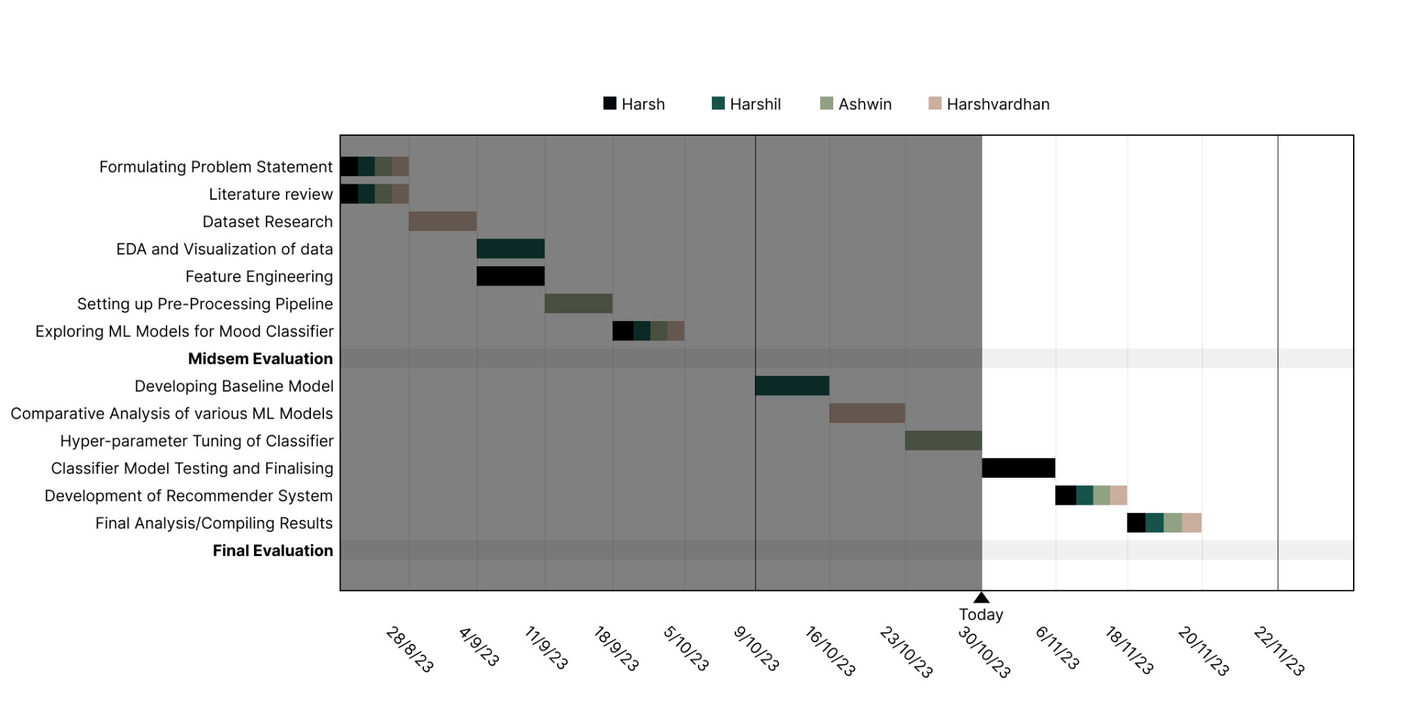
Timeline
We’re ahead of the proposed timeline!

Slide 14
Individual Contribution
Ashwin R Nair
Setting Up and Designing a robust pre-processing pipeline, ensuring data cleaning,feature scaling, and encoding for optimal model performance. Implemented techniques to handle missing values and outliers, enhancing data quality.
Harsh Popat
Enhancing model predictive power by feature selection and hyperparameter used to improve model performance and help to get valuable insights from the data.
Harshil Mital
Performing Exploratory Data Analysis (EDA). Also, experimented with various ML models and conducting performance evaluations, leading to the selection of the most suitable algorithms.
Harshvardhan Singh
Did literature review on related research to inform data selection and model design, ensuring the project’s foundation is built on sound empirical and theoretical knowledge. Explored Various ML models to get familiar with the available techniques.

Slide 15
THANK YOU!
Ashwin R Nair (2020037)
Harsh Parimal Popat (2021048)
Harshil Mital (2021050)
Harshvardhan Singh (2021052)

